Slide 1
THANK YOU TO OUR 2023 GOLF OUTING SPONSORS

Slide 2
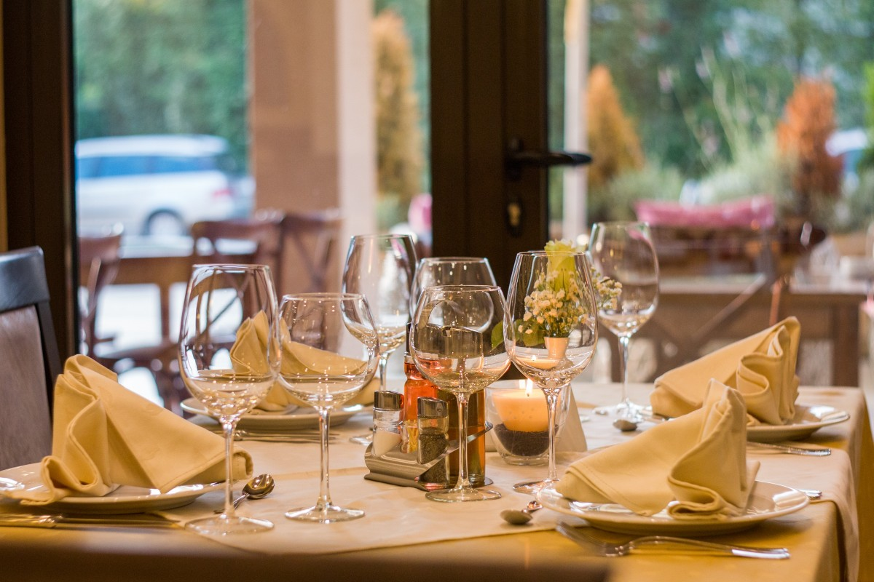
THANK YOU TO OUR DINNER SPONSORS
GEORGE & RUTH HARMS
MANASQUAN BANK
MARINER FOUNDATION
BONNIE & JOHN O’NEILL
RAYMOND WALSH

Slide 3
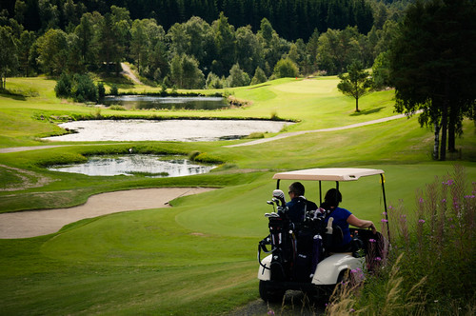
THANK YOU TO OUR BEVERAGE STATION SPONSORS
GORDON STROUT
LEGGETT’S
BAR ANTICIPATION

Slide 4
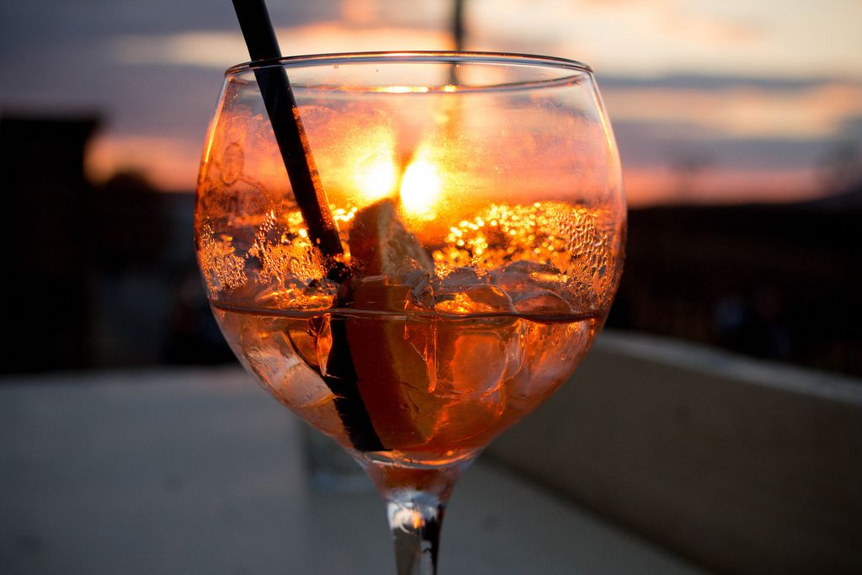
THANK YOU TO OUR COCKTAIL HOUR SPONSOR
THE DiFEO FAMILY

Slide 5
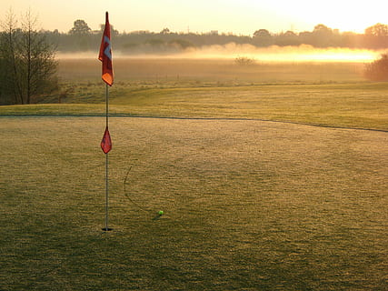
THANK YOU TO OUR FLAG SPONSORS
Michael Ayars
Devon Clancy
Difeo Family
Art Fareen
Anthony Grillo
Brendan Judge

Slide 6
THANK YOU TO OUR FLAG SPONSORS (Cont’d)
Morgan Stanley: Richard Kelly
Michael Mattia
Mr. Michael P. Ritacco
Spirit of ‘76
James Wingard

Slide 7
THANK YOU TO OUR TEE SPONSORS
Robert Allison
Jerry Bailey
James Clabby
Frank Fischer
Hayes Family
Bret Kaufman

Slide 8
THANK YOU TO OUR TEE SPONSORS (Cont’d)
Ocean Pointe
Nicholas Raffetto
Reilly Bonner Funeral Homes, LLC
George Steiner
Tedd Vitale
John & Judy Weaver

Slide 9
THANK YOU TO OUR TEE SPONSORS (Cont’d)
Mike Collins
Debbie Curto
Campi Dental
Jon Eckert
Four Winds
Michael Guilano

Slide 10
THANK YOU TO OUR TEE SPONSORS (Cont’d)
Tom Heavey
Mike Hirsh
Richard Kelly
Kevin O’Brien
Michael O’Hare

Slide 11
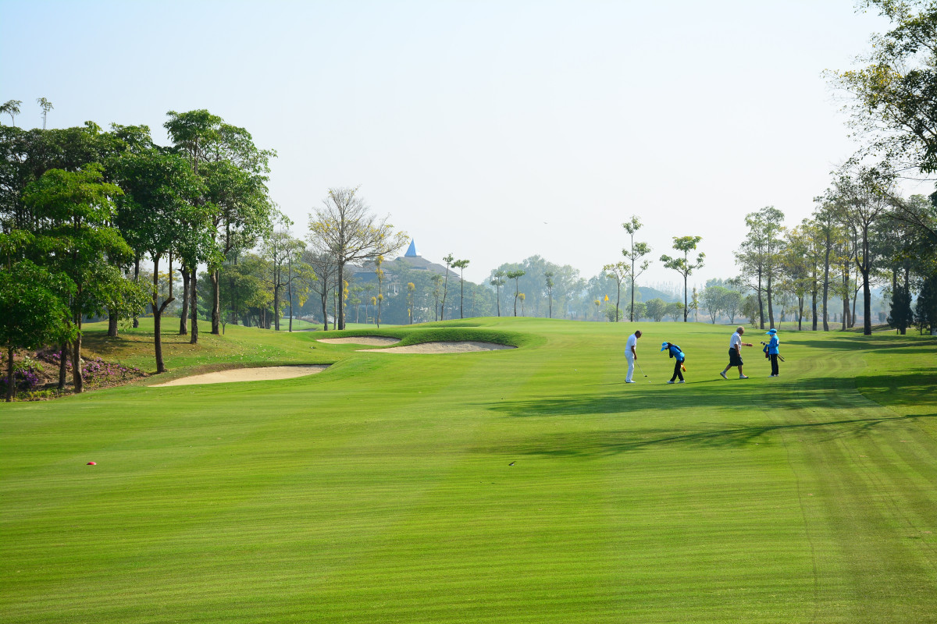
THANK YOU TO OUR GOLF OUTING DONORS
Mark Feeley
Michael O’Hare

Slide 12
2023 GOLF OUTING AUCTION ITEMS

Slide 13
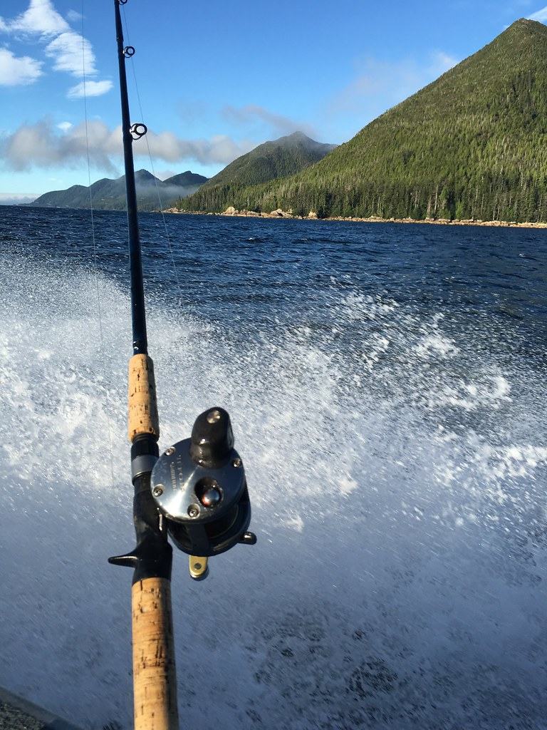
A Full Day Inshore fishing Trip for 4 w/ lunch
This Photo by Unknown Author is licensed under CC BY-NC-ND

Slide 14
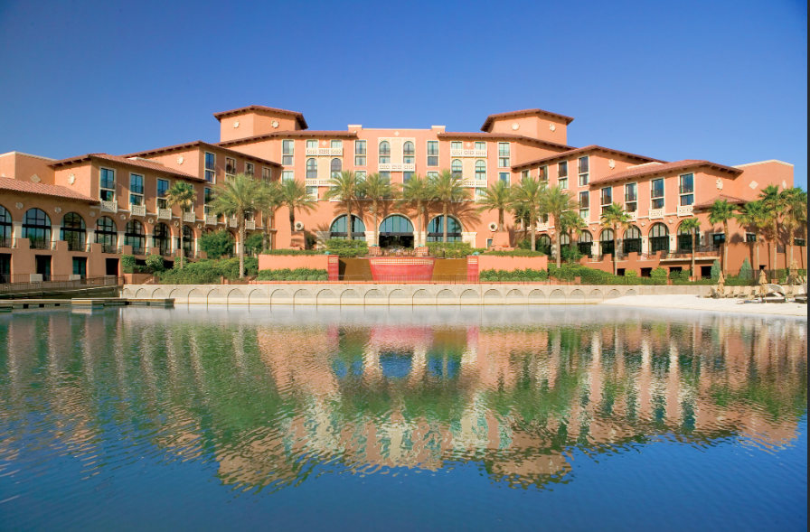
A Golf Experience
That You Will Remember Forever
Reflection Bay Golf Club
& Westin Lake Las Vegas Stay

Slide 15
World Renowned Reflection Bay Golf Club, Lake Las Vegas

Slide 16
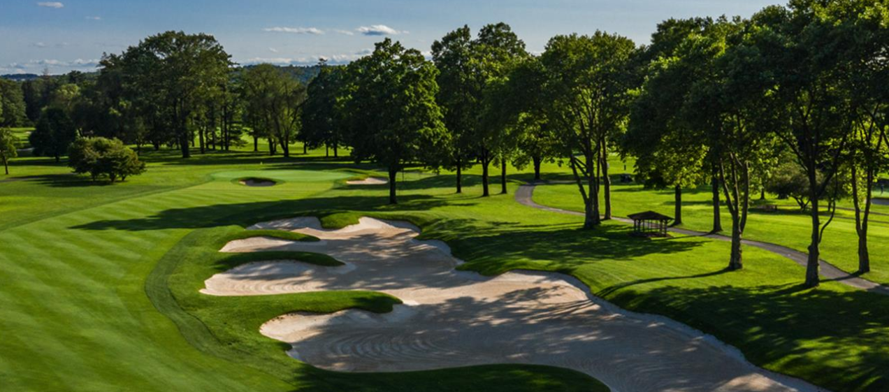
ROUND OF GOLF
SAUCON VALLEY COUNTRY CLUB
BETHLEHEM, PA

Slide 17
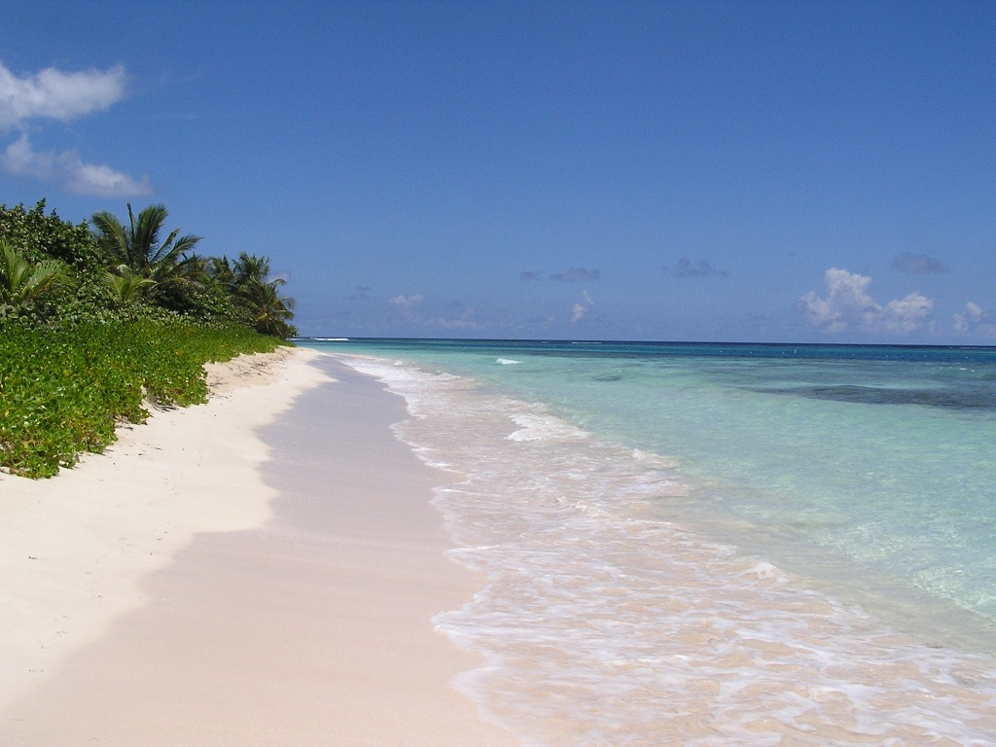
ONE WEEK STAY IN BEAUTIFUL
ISABELA, PUERTO RICO
3 BEDROOM 2 BATHROOM CONDO
A 10-MINUTE WALK TO JOBOS BEACH!
This Photo by Unknown Author is licensed under CC BY-SA

Slide 18
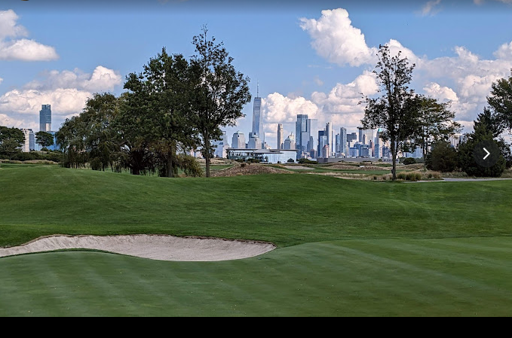
ROUND OF GOLF
LIBERTY NATIONAL GOLF COURSE
JERSEY CITY, NJ

Slide 19
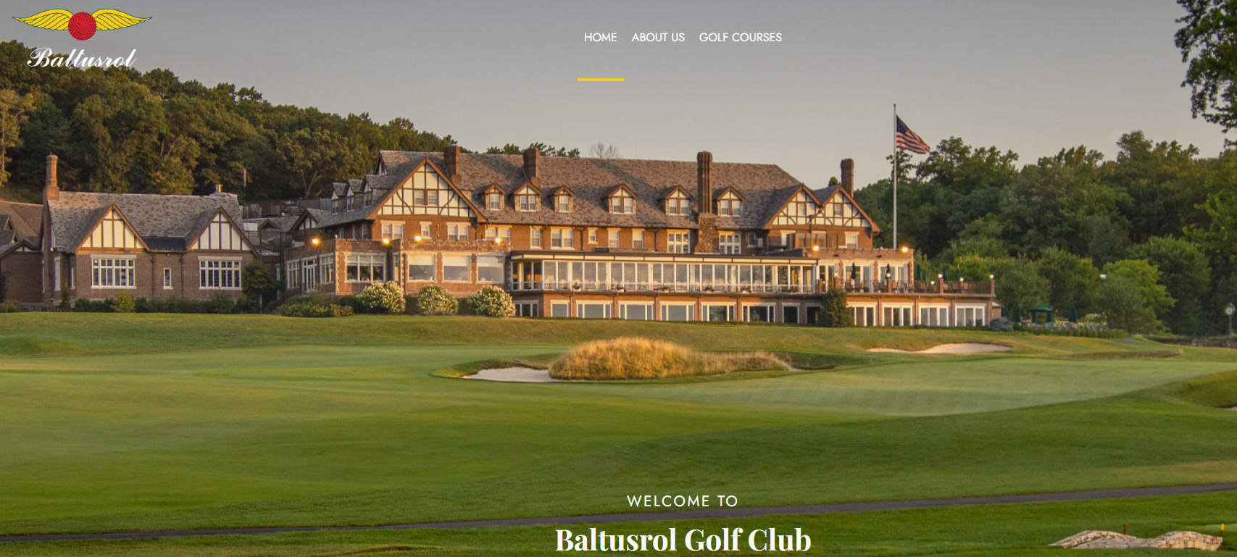
ROUND OF GOLF
BALTUSROL GOLF CLUB

Slide 20
Sky Track

Slide 21
Put Your Health First!
1 YEAR MEMBERSHIP
to
The Best Fitness Club at The Jersey Shore!

Slide 22
LOBSTER BAKE
FOR 14!
1.5 LB Lobsters- steamed, cracked, & served with melted butter & lemon
Jersey Corn on the Cob
Red Bliss Potatoes with Old Bay & butter

